Slide 1



Slide 2
What is ARIZONA@WORK?
A partnership of workforce development organizations providing innovative workforce solutions to employers & job seekers
One resource, over 40 locations throughout Arizona
Notes:
How many of you have heard of Arizona@Work? How many of you have accessed the services available through Arizona@Work?

Slide 3
What does ARIZONA@WORK do?
Develop Arizona’s workforce and match employers with job seekers
Help employers recruit, develop, and retain the best employees for their needs
Serves job seekers of all ages, skill sets and experience levels
Notes:
ARIZONA@WORK is divided into 12 local areas throughout Arizona to tailor support and job opportunities to the community. Each local area works with its local partners (businesses, education institutions, local government entities, etc.) to identify job opportunities. They support job seekers to match with the jobs and also assist with skill development and job seeking activities. There are two local areas in Maricopa County – City of Phoenix and Maricopa County.

Slide 4
Who May Use ARIZONA@WORK Services?
  Employers (all types of businesses)
  Job Seekers
  Individuals aged 18 years and older
  In-School Youth (14-21 yrs) and Out-of-School Youth (16-24 yrs)
  Veterans
  Individuals with disabilities
  Individuals receiving TANF (cash assistance) or SNAP
  (food stamps)
Notes:
ARIZONA@WORK is divided into 12 local areas throughout Arizona to tailor support and job opportunities to the community. Each local area works with its local partners (businesses, education institutions, local government entities, etc.) to identify job opportunities. They support job seekers to match with the jobs and also assist with skill development and job seeking activities. There are two local areas in Maricopa County – City of Phoenix and Maricopa County.

Slide 5

SERVICES FOR EMPLOYERS
ARIZONA@WORK partners with employers
to meet their workforce needs
CUSTOMIZED RECRUITMENT
  Job Posting on Arizona Job Connection
  Candidate Matching and Pre-Screening
  Skills Assessment to identify qualified applicants
  Hiring Events
  Special Recruitment Services

Slide 6

SERVICES FOR JOB SEEKERS
ARIZONA@WORK offers an array of services that are tailored to meet the unique needs of the individual
Services* for job seekers may include:
  Job search assistance
  Referral to employment opportunities
  Skill and career interest assessments
  Skills upgrade such as certification and training
  Resumé review and development
  Interview preparation
  Career Training and Certifications
  Apprenticeship opportunities
*Services vary depending on program eligibility.
Notes:
How many of your students will not have a planned path for college? How can Arizona@Work help with those students who do not head to college after high school?

Slide 7

MODERN SERVICES FOR TODAY’S JOB SEEKER
Discover career passion
Create an employment plan
Registration in our job search database –
Arizona Job Connection (AJC)
www.azjobconnection.gov
Utilize our Resource Rooms for job searching, job search assistance, faxing, printing, and more.
Notes:
How many of you are aware of students whose families would benefit from the Arizona@Work resources? How much do these services cost the student or their family members?

Slide 8

ADDITIONAL ARIZONA@WORK SERVICES
ARIZONA@WORK partners to meet the needs of employers and job seekers
  Free workshops that cover Resumé Writing, Interview Skills, and
  tips for job searching, and more
  On-Site Job Fairs and Hiring Events
  Recruitment of employers in priority sector and other market areas

Slide 9
Workforce Innovation and Opportunity Act (WIOA)
Describes the required efforts for States and local communities to match employers with job seekers
Provides funding, which allows Arizona to provide employment services at no charge

Slide 10
WIOA continued…
Provides state and local areas flexibility to collaborate across systems so there is a stronger alignment of the workforce, education, and economic development systems
Addresses the employment and skills needs of current employees, jobseekers, and employers.

Slide 11
Workforce Innovation and Opportunity Act (WIOA)
Adult Program
Provides workforce investment activities that increase the employment, retention, and earnings of adults ages 18 and older.
Improve the quality of the workforce, reduce welfare dependency, and enhance the productivity and competitiveness of the nation’s economy.
All adults must:
Be U.S. citizens or lawfully admitted permanent resident aliens, refugees, asylees, parolees or other immigrants authorized to work in the United States.
Meet Selective Service Registration requirements, if applicable.

Slide 12
WIOA continued….
Youth Program
Designed to prepare Arizona’s youth to enter either post-secondary education, training or employment upon completion of secondary education.
Serves Out-of-School Youth (ages 16 -24) and In-School Youth (ages 14-21)
Must meet income requirement, if required and have at least 1 of 8 specified barriers to employment:
School dropout.
Basic skills deficient.
English language learner.
Pregnant or parenting.
Homeless, runaway, or foster child.
Ex-offender.
Disability.
Requires assistance to complete an educational program, or to secure and hold employment.

Slide 13

WIOA continued….
Youth Program Services include:
  Tutoring, training, and instruction for completion of secondary school
  Mentoring
  Work experience through internships, apprenticeships, job shadowing
  Occupational skills training
  Leadership development
  Supportive services
  Guidance counseling

Slide 14
WIOA continued….
Wagner-Peyser Act of 1933 –
National Employment System
Provides employment and training services to employers and individuals seeking new jobs, better jobs or first jobs.
Participants are able to locate and retain suitable jobs and build sustainable careers
Services include:
  Resume development
  Job clubs
  Interview skills
  Job matching, and
  Career exploration

Slide 15
The WIOA Title IB Dislocated Worker (DW) program
Provides workforce related core, intensive and training services to individuals who have been terminated through no fault of their own, laid off, or have received notice of termination or layoff, from employment generally due to plant closures or downsizing.
Self-employed individuals who are unemployed due to general economic conditions and individuals who meet the WIOA definition of a displaced homemaker may also be eligible for services.

Slide 16
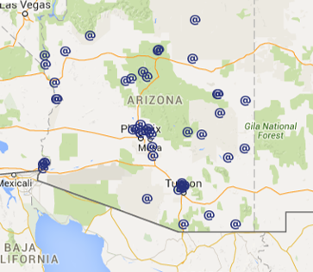

HOW TO GET STARTED?
Contact Us!
www.ArizonaAtWork.com
Or visit any ARIZONA@WORK location to meet with a Workforce Specialist.

Slide 17
WHAT IS SNAP E&T?
Supplemental Nutrition Assistance Employment and Training
Federal employment and training program for SNAP recipients.
Provides education and skills training to SNAP participants to help them prepare for work and reduce their need for SNAP.
Every state is required to design and operate a SNAP E&T program

Slide 18
SNAP E&T COMPONENTS
Job search activities
Job search training, including skills assessments, job finding clubs, training in employability techniques, and job placement services
Programs designed to improve the employability of eligible individuals through actual work experience, training, or both
Educational programs to improve basic skills and literacy
Programs designed to increase an individual’s self-sufficiency through self-employment
Programs to provide job retention service for up to 90 days following employment

Slide 19
WHAT IS SNAP CAN?
Supplemental Nutrition Assistance Program
Career Advancement Network (SNAP CAN) is a(n)…
Federal, State, and Local Community reimbursement model partnership between the U.S. Department of Agriculture, Arizona Department of Economic Security (ADES), and community-based organizations that are dedicated to providing employment readiness opportunities to eligible SNAP benefit recipients.
Opportunity to leverage and grow existing expertise in the community to expand reach to individuals seeking employment and training assistance.
A meaningful, intentional way to assist SNAP participants move toward career pathways to achieve self-sufficiency through living-wage employment.

Slide 20
WHY SHOULD YOUR ORGANIZATION BECOME A SNAP CAN PARTNER?
#SNAPCAN help raise awareness of the services you provide to low-income individuals in your community.
#SNAPCAN connect you to a network of community partners who share the same goal of providing participants with the tools and resources they need to overcome barriers and obtain employment.
#SNAPCAN provide access to federal dollars to expand your organization’s capacity and reach to serve your community.

Slide 21






Who are the current
SNAP CAN Partners?

Slide 22
WHAT ARE THE SNAP CAN PARTNER RESPONSIBILITIES?
Assess participant skills, strengths, educational background, and barriers to employment
Provide case management support to assist participant with achieving employment goals
Provide eligible employment and training services
Track participant information such as:
  Program Participation (dates/ # of hours)
  Support Services Provided
  Job Placements
  Wages
Submit reports and data to DES on SNAP CAN participants

Slide 23
WHO ARE THE PARTICIPANTS?
  Most likely, the participants you will serve as a SNAP CAN Partner are those you are already serving from your community.
  SNAP benefit recipients seeking assistance with obtaining employment or advancing their career
  An eligible SNAP CAN participant must:
  Be receiving SNAP benefits in the month you delivered services and are requesting reimbursement
  Not be receiving TANF Cash Assistance Benefits
  Agree to and acknowledge participation in the SNAP CAN Program

Slide 24
HOW DOES THE REIMBURSEMENT MODEL WORK?
ADES contracts with community-based partners to provide eligible E&T services
Community-based partners use non-federal funds to pay for allowable expenses and then submits an invoice to ADES for reimbursement
ADES passes reimbursement back to community based partners to reinvest in E&T services

Slide 25
HOW MUCH IS THE REIMBURSEMENT?
ADES directs 45% of the total cost of an allowable service provided to an eligible SNAP CAN participant back to the SNAP CAN Partner that provided the original activities.
Reimbursement is only provided if allowable activities are initially paid for with non-federal funds that are not used to match other federal funds.
  State, county, or city funds
  Foundation Funds
  Donations from private funds or non-profits

Slide 26
WHAT ARE THE Next steps?
Are you ready to see what #SNAPCAN do for your organization and community?
Please visit:
www.AZSNAPCAN.com
to complete the
SNAP CAN Potential Partner Assessment
found under “Becoming a SNAP CAN Partner”
Or email:
SNAE&Thelp@azdes.gov

Slide 27
Thank You!

Slide 28


Slide 29





Job Seekers
ARIZONA@WORK is here to help job seekers like you. We have the services and programs you need to find, prepare for and keep the right job.
Employers
ARIZONA@WORK partners with employers to meet their workforce needs. With locally based services, we have the network to connect people and jobs.
ArizonaAtWork.com/Phoenix
Locations
West Job Center 3406 N. 51st Ave. Phoenix, AZ 85031 623-245-6200 | North Job Center 9801 N. 7th St. Phoenix, AZ 85020 602-861-0208 | South Job Center 4732 S. Central Ave. Phoenix, AZ 85040 602-534-5902 * Temporary Location | South Job Center 4635 S. Central Ave. Phoenix, AZ 85040 602-771-0630 * New Location this summer | Maricopa - East 735 North Gilbert Road Suite 134 Gilbert, AZ 85234 Phone(602) 372-9700 | Maricopa - West 1840 North 95th Avenue Suite 160 Phoenix, AZ85037 Phone(602) 372-4200

Slide 30
Who We Are
ARIZONA@WORK is the statewide workforce development network that helps employers of all sizes and types recruit, develop and retain the best employees for their needs. For job seekers throughout the state, we provide services and resources to pursue employment opportunities.
Our goal is to strengthen Arizona’s economy by developing our state’s workforce and matching employers with job seekers.

Slide 31
How we can help
There are many ways we can help your clients get back to work, including:
Posting their resume on the state’s largest workforce database; Arizona Job Connection (AJC)
Providing them with career guidance and assessment
Matching them with job opportunities that are the right fit for them
Preparing them with customized training opportunities, education and skills development
Hosting hiring events where they can connect with employers
Directing them to partner community based organizations and social services, if needed

Slide 32

Arizona Job Connection (AJC)

Slide 33


Assessment Tools
Notes:
My Next Move
My Next Move is an interactive tool for job seekers to learn more about their career options. The site has tasks, skills, salary information for over 900 different careers. Our Career Advisors find the O*NET Interest Profiler to be a valuable tool that offers personalized career suggestions based on a person's interests and level of work experience.
ACRC
A major initiative set forth by Gov. Ducey in partnership with AZ@WORK and OEO. Tool prepares job seekers for success by demonstrating their command of seven sill area that are relevant to every occupation, industry and career pathway. These skill areas consist of: Applied Math, Reading for Information, Locating Information, Communicating effectively, Conveying professionalism, Teamwork & Collaboration and Thinking Critically/Problem Solving.
2 Phases: This is currently being provided to customers that enroll into our Career Services program with WIOA, and will be available for all of our customers this summer.

Slide 34
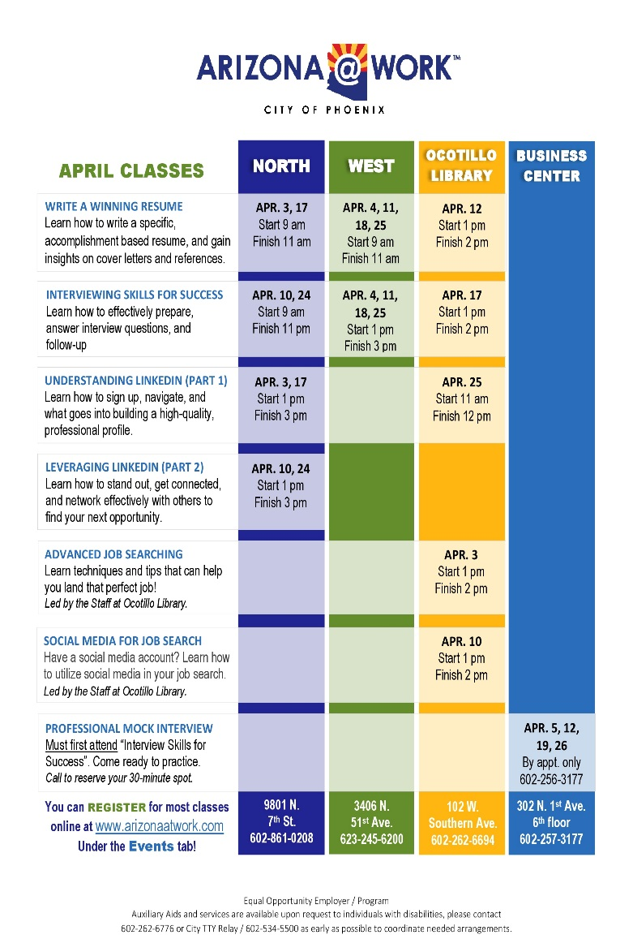

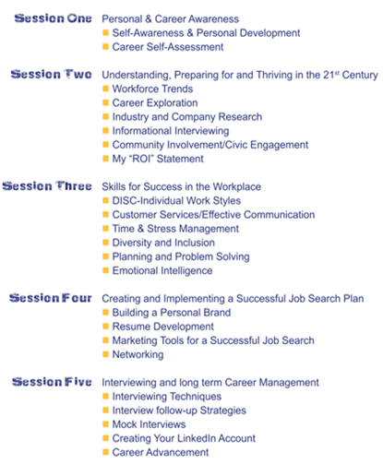
Skills Development
Notes:
Public Workshops
Learn how to write a specific, accomplishment based resume, get insights on cover letters and references
Learn how to effectively prepare, answer interview questions and follow-up
How to sign-up, navigate and build a high-quality professional profile. How to stand out, get connected and network
How social media can assist in finding employment
SOAR
Work one on one with a Career Advisor
Assess your transferable skills, strengths, and areas needing improvement.
Match skills / background to occupation / career.
Determine if training is needed to increase your marketability.
Assist you with re-employment opportunities in a comparable profession or career.

Slide 35
Career Services: (Workforce Innovation & Opportunity Grant -WIOA)
Basic Services | Individualized Services | Follow-up Services
All Job Center customers have access and includes: Membership Card Help with online job bank registration (azjobconnection.gov) Set up and email account Use of computers and equipment Referrals to community resources Public workshops On-site events and Job Fairs | Services beyond basic & requires case management: Comprehensive and specialized assessments SOAR – Job Readiness Workshops Basic Computer Classes Occupational Training Professional Resume creation and critique Job Coaching and Employment referrals ACRC Certification Support Services | Customer that obtain employment: Minimum of 12 months Customers may decline this service Additional career planning and counseling; Information pertaining to additional educational opportunities; and Referral to supportive services available in the participant’s community

Slide 36


Youth Programs
Notes:
Phoenix Youth RISE
This program is open to youth who live in the city of Phoenix, are between the ages of 16 – 24, and have the legal right to work in the US. This is a 5-week paid internship (minimum wage) during the summer months. Employers are varied and located throughout he valley. This program is funded by Phoenix tax payer dollars. The goal of this program is to provide youth with a real world-of-work experience, on the job. For many youth who participates this is usually their very first job.
WIOA Youth Program
This program serves disconnected youth, ages 16 – 24. Disconnected is identified as a youth who neither employed nor participating in any educational program. Youth in this program often have barriers such as:
Being homeless
Basic skills deficient
Pregnant or parenting
Justice involved
Parents are or have been incarcerated
Foster
The primary goal of the WIOA youth program is to provide youth with guidance and assistance in identifying a meaningful career path, providing them with skills to pursue the career path, mentorship, leadership among other tools and skills sets.
The City of Phoenix has subcontracted out the Youth program to the following: Arizona Center for Youth Resources, YMCA, Jewish Family and Children Services, and Chicanos por la Casa
AZ Highway Construction Training Program
This program is for youth, ages 18 – 24, who have an interest in the construction industry. This is a 10-week long program that gives the youth with 8-9 weeks of paid internship at $15/hour with a construction employer.

Slide 37

Strengthening Working Families Initiative Grant (SWFI)
Eligibility
Now serving all zip codes! Must be 17 years or older Have a HS diploma or GED At least 1 dependent who is 13 or younger Be legally authorized to work in the US.
Training Available
Get trained as a Sales Agent or Claims Adjuster Training and certification as a Cisco Network Administrator (A+, CCENT, CCNA) Earn your A+ certification in as little as 5 weeks CompTIA A+ and Network+ training Training to earn the CompTIA S+ or Cisco CCNP Security certification Training and preparation to become licensed as a Nursing Assistant Training and preparation to become a Certified Medical Assistant Day, evening, weekend and online classes available!

Slide 38
Earn and Learn
On the Job Training (OJT) Grants | Cohort Training Grants | Incumbent Workforce Training (IWT) Grants
OJT is an “earn-as-you learn” training option that benefits both the local employer and job seekers The primary purpose of the OJT is to create a compelling reason for employers to hire individuals that meet their overall hiring requirements, but lack important work life experience. OJT enables employers to hire new employees and train them at their place of business OJT reimburses 50 percent of the new employee wages during training up to $4,000 depending on the industry | Cohorts are industry lead, combining our WIOA approved training partners and funding A program that fits well for larger hiring needs for certifications that are in high demand Allows employers to train their own candidates for a specific certification while threading critical on boarding skills into the program The program is designed to connect job seekers with education and interview opportunities, seamlessly Program Pilot Examples: CompTIA Fundamentals with help desk and customer service certifications CompTIA A+ as well as CompTIA N+ and Security+ Customer Service Certification | IWT training provides incumbent workers (working 6 months or longer, full time) with the necessary skills to retain their positions at the company Increases the employee’s competitiveness via skills Provides 50-90% financial reimbursement to employers who train existing workforce Reimbursements are based on company size Reimbursement is up to $50,000 per fiscal year
Notes:
CCNA Program
• Starts April 30th
• 8 Week Training
• Evening Sessions
Network+ & Security+ Program
• Starts April 30th
• 16 Week Training
• Evening Sessions
Entry-Level Program
• Starts May 14th
• 12 Week Training
• Morining and Afternoon Sessions
Entry-Level Program
• Starts June 25th
• 12 Week Training
• Evening Sessions
TTY Career College,
2200 N. Central Ave., Ste. 400
Phoenix, AZ 85004

Slide 39

LaSetta Hogans, MSW, GCDF
Senior Workforce Development Specialist
ARIZONA@WORK City of Phoenix
Lasetta.Hogans@phoenix.gov
602-495-3609
West Job Center 3406 N. 51st Ave. Phoenix, AZ 85031 623-245-6200 | North Job Center 9801 N. 7th St. Phoenix, AZ 85020 602-861-0208 | South Job Center 4732 S. Central Ave. Phoenix, AZ 85040 602-534-5902 * Temporary Location | South Job Center 4635 S. Central Ave. Phoenix, AZ 85040 602-771-0630 * New Location this summer | Maricopa - East 735 North Gilbert Road Suite 134 Gilbert, AZ 85234 Phone(602) 372-9700 | Maricopa - West 1840 North 95th Avenue Suite 160 Phoenix, AZ85037 Phone(602) 372-4200

