Slide 2
2018 Composition of Arizona Legislature
House of Representatives:
35 Republicans
25 Democrats
State Senate:
17 Republicans
13 Democrats

Slide 3
2019 Composition of Arizona Legislature*
House of Representatives:
31 Republicans
29 Democrats
State Senate:
17 Republicans
13 Democrats
* Pending count of remaining ballots

Slide 4
New Legislative Leadership
House of Representatives:
Speaker – Rusty Bowers
Majority Leader – Warren Petersen
Majority Whip – Becky Nutt
Democratic Leader – Charlene Fernandez
Democratic Asst Leader – Dr. Randy Friese
Democratic Co-Whips – Athena Salman and Reginald Bolding
State Senate:
Senate President – Karen Fann
Majority Leader – Rick Gray
Majority Whip – Sonny Borrelli
Democratic Leader – David Bradley
Democratic Asst Leader – Lupe Contreras
Democratic Co-Whips - Jamescita Peshlakai and Lisa Otondo

Slide 5
Interesting Facts About the New Legislature
Closest partisan split since 1964
6 Democratic legislators will represent districts with a majority of Republican registered voters
House will have 20 freshmen legislators; Senate will have 1 freshman
13 out of 30 Senators are women; 22 out of 60 Representatives are women

Slide 6
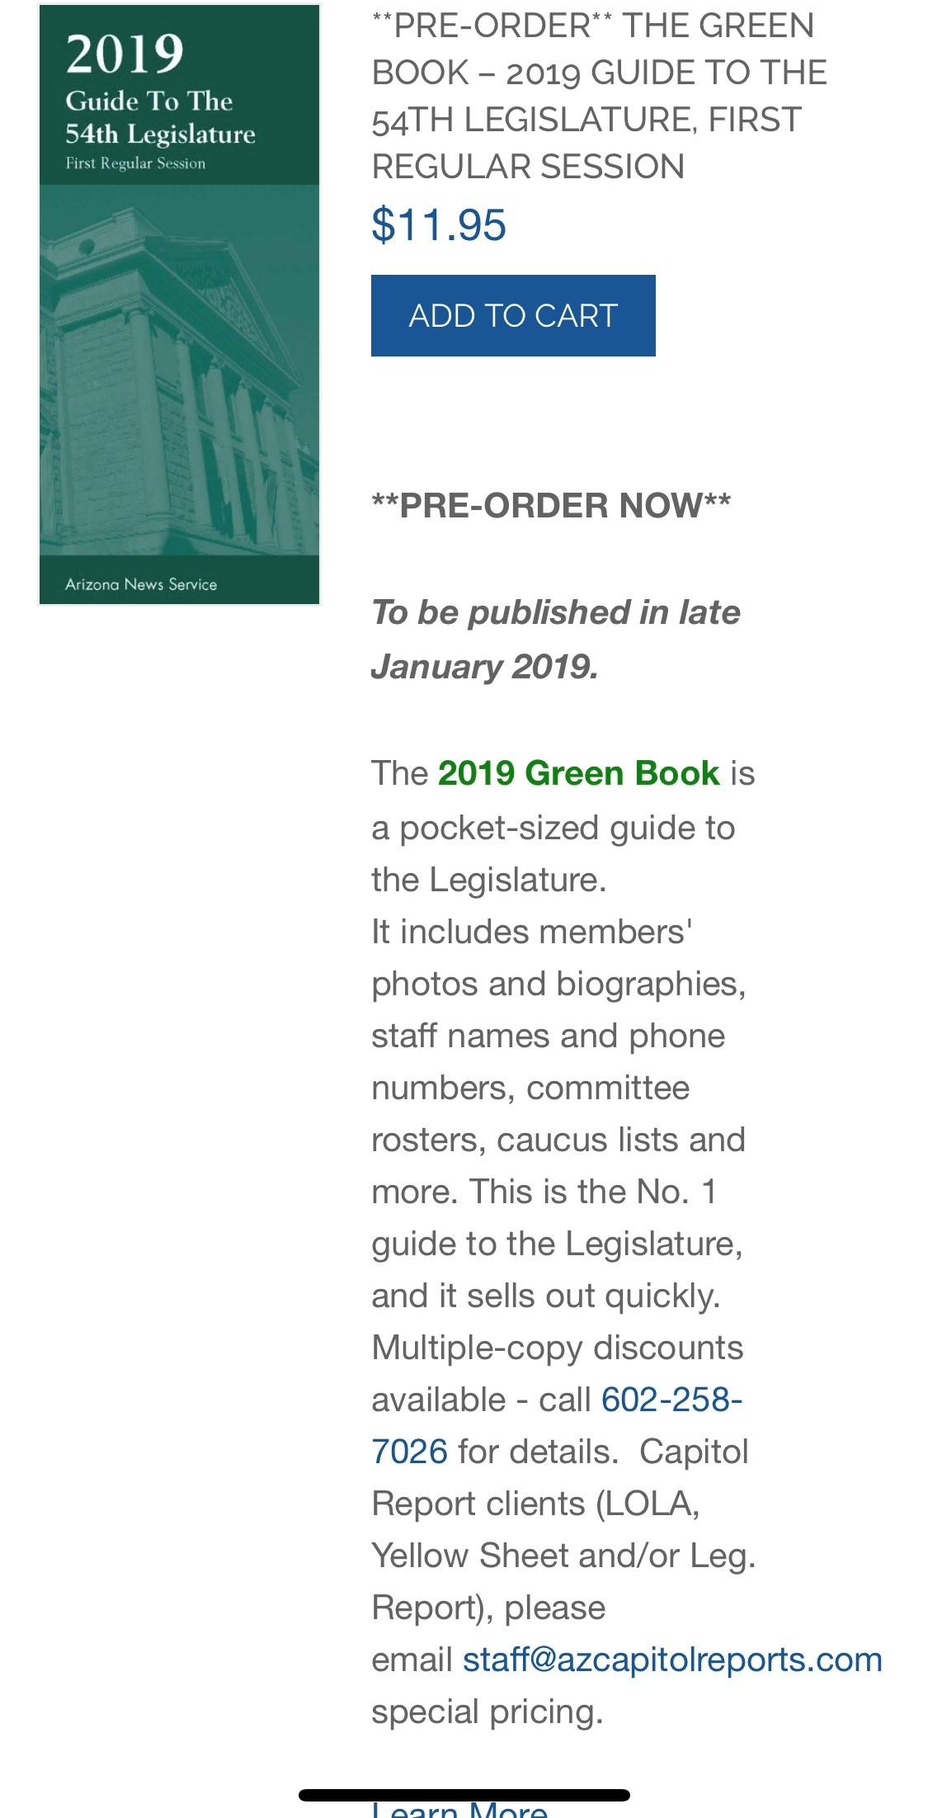
2019 Green Book
Azcapitoltimes.com
$11.95

Slide 7
Some Good News!
The General Fund is estimated to have an additional $200 million of ongoing revenue;
The state is expected to have $900 million in new one-time revenue

Slide 8
Key Issues for the Legislature in 2019
Arizona’s public schools still have $843 million less in annual state funding than a decade ago;
Funding for state universities is down 35% since 2008 and tuition is up 113% and state funding for Maricopa and Pima Community Colleges has been eliminated;
A new report found the lowest income 20 percent of Arizona taxpayers pay the sixth highest state and local tax bill for this income group in the country;
Most rank-and-file state employees have not received a pay raise in more than a decade.

Slide 9
Contact information
David Lujan – 602-266-0707 ext 203
Dlujan@AZEconCenter.org
Twitter @DavidLujan
Social Media
Twitter @AZEconCenter
Facebook https://www.facebook.com/AZEconCenter/
Website: www.azeconcenter.org

