Slide 2
1 in 4 Arizona children live in poverty.
Arizona wages below national average.
27% of Arizona Latino population live in poverty.

Slide 3
Arizona has cut taxes or added exemptions or credits every year since 1990.
Tax cuts enacted since 1990 will cost the state’s general fund more than $4.4 billion in annual revenues when adjusted for inflation.

Slide 4
CORPORATE INCOME TAX REVENUE IS DECLINING 2017 Collections Are Lowest Since 1993
*Projections
Source: Joint Legislative Budget Committee staff, Historical General Fund Revenue Collections and Revenue and Budget Update, November 2017
Notes:
Primary reasons are corporate income tax rate reduction and 100% single sales factor
FY 2017 was projected to have revenue of $420 million; ended up being $368 million

Slide 5
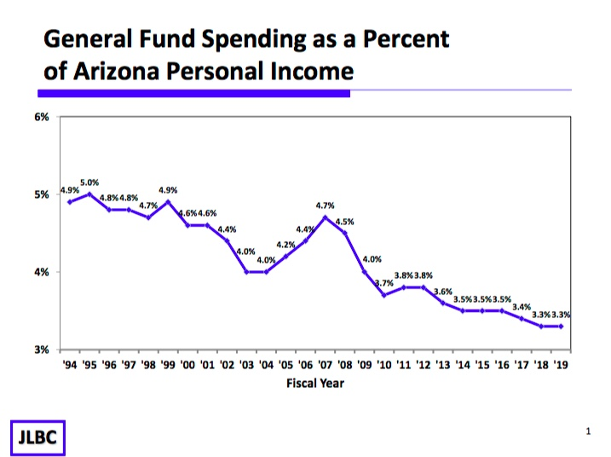

Slide 6
Funding for all state agencies is below 2008 levels with the exception of Department of Child Safety and Department of Corrections

Slide 7
ARIZONA’S INVESTMENT IN CHILD CARE SUBSIDIES
HAS FALLEN

Slide 8
FUNDING CUTS MEAN FEWER CHILDREN ARE ABLE TO RECEIVE CHILD CARE SUBSIDIES
Estimated Caseloads Based on Appropriations

Slide 9
Tuition* Has Increased While State Funding Has Fallen 2007-2008 to 2017-2018 (adjusted for inflation)

Slide 10
INCARCERATION RATES
(Per 100,000 People)
https://www.prisonpolicy.org/global/2016.html

Slide 11
*Figures have been adjusted for inflation and student growth. “Other” includes early education, 9th grade Joint Technical Education Districts, pay and operations.

Slide 12
2017 Alliance Bank CEO Survey
Education! Education! Education!
#1 Business challenge: Education system & workforce
#1 Issue State Government Should Address: K-12 Education
#1 Issue Local Government Should Address: K-12 Education
#1 Action State Government Could do to Improve Business Climate: Increase K-12 Funding

Slide 13
Which approach do Arizonans prefer for balancing the budget?
State Innovation Exchange Statewide Poll, December 17-28, 2017
Raise revenue 67%
Cut spending 24%

Slide 14
Contact information
David Lujan – 602-266-0707 ext 203
Dlujan@AZEconCenter.org
Social Media
Twitter @AZEconCenter
Facebook https://www.facebook.com/AZEconCenter/
Website: www.azeconcenter.org

