Slide 1
LISC Phoenix
Maricopa Family support alliance
August 17, 2018

Slide 2
Department of the Treasury non depository bank
Grant making for non profit capacity building
Thought leadership
Community Engagement
Healthy Communities
Gentrification/Displacement
Economic Resilience
CDFI (Community Development Financial Institution)
Notes:
Tax credits

Slide 3
LISC Phoenix
Transit Oriented Development Focus
-Affordable housing (Zero to 3000 units on the Rail)
-Economic Development
-Commercial Corridors
-Financial Opportunity Centers (Workforce)
-Healthy Communities

Slide 4
Comprehensive Community Development
Determinants of Health
Notes:
Housing transportation cost index

Slide 5
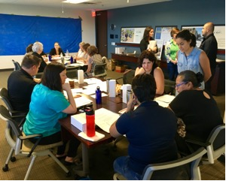
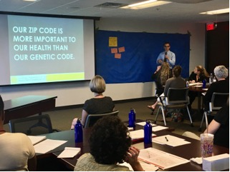
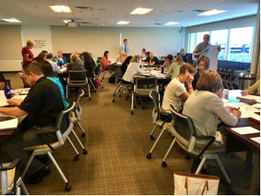
Incubator for multi-sector collaborators
Mini Grants
AZ Partnership for Healthy Communities
www.livewellaz.org

Slide 6
COMMUNITY ENGAGEMENT

Slide 7
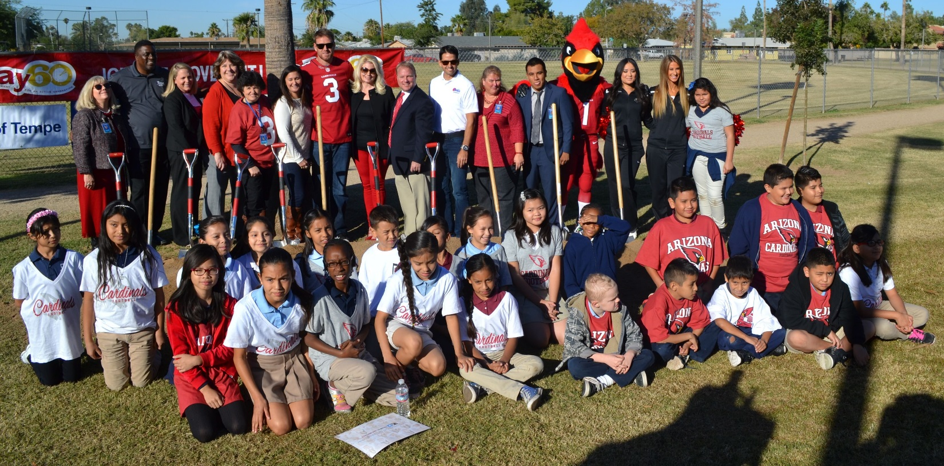
The NFL Foundation/LISC Grassroots Program used to renovate Tempe’s Escalante Park, including a new football field!
Sports and Rec

Slide 8
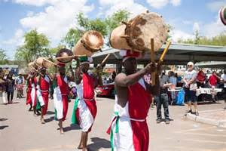
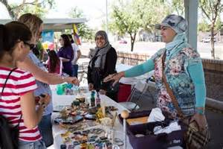
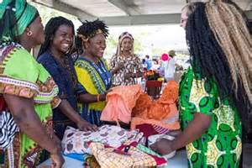
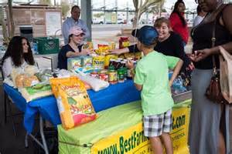
World Bazaar
Creative Placemaking
Notes:
May 6th
19th ave
10-2

Slide 9
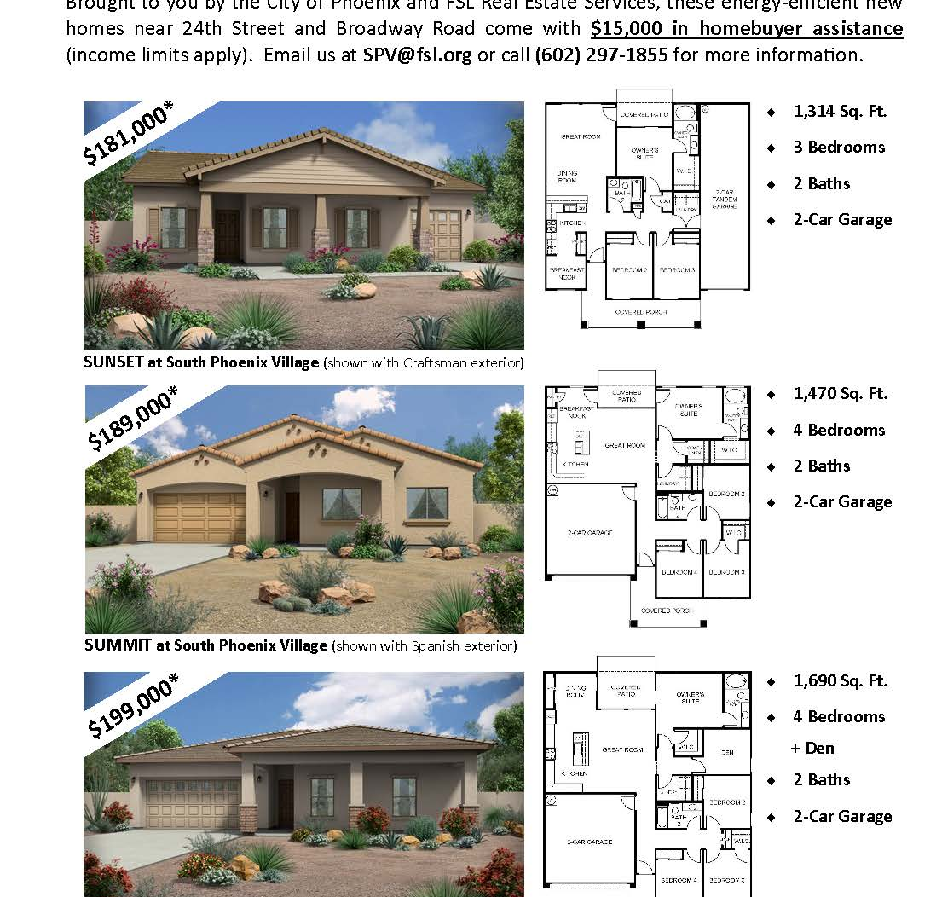
South Phoenix Village Community Charrette
FSL, City of Phoenix
South Phoenix Village, Phoenix
121 Affordable Single Family Homes, Infill Redevelopment Project
$ 3,000,000 LISC Investment
$ 22,422,222 Total Development Cost
Under construction
Notes:
https://www.phoenix.gov/nsdsite/Pages/South-Phoenix-Village-.aspx
https://www.fsl.org/affordable-homes-for-sale
https://www.youtube.com/watch?v=jorFyr6kH0I
For people who want a small town feel in the middle of it all, the South Phoenix Village neighborhood offers proximity to the airport, several freeways, and outdoor recreational amenities such as South Mountain and the Rio Salado Trail. South Phoenix Village is a diverse, yet close-knit community where you’re never far from your next adventure.
FSL, in partnership with the City of Phoenix Neighborhood Services Department, is leading an infill redevelopment project in South Phoenix Village (24th Street east to 32nd Street / Broadway Road south to Roeser Road). Although this area was originally subdivided in the 1940’s, there are a number of vacant lots in the community. Over a span of many years, the City of Phoenix acquired approximately 120 of these lots. FSL, with our contractor partner MHI Residential, Inc. (ROC #149764), will build 120+ energy-efficient homes ranging in size from 1,300 to 1,700 square feet and starting in the $180’s. The homes come with $15,000 in home buyer assistance in the form or a zero percent interest deferred loan that is fully forgivable after 15 years.

Slide 10
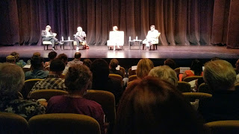
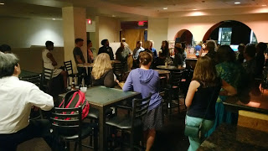
Community Discussion
Social Justice
Notes:
Community events

Slide 11
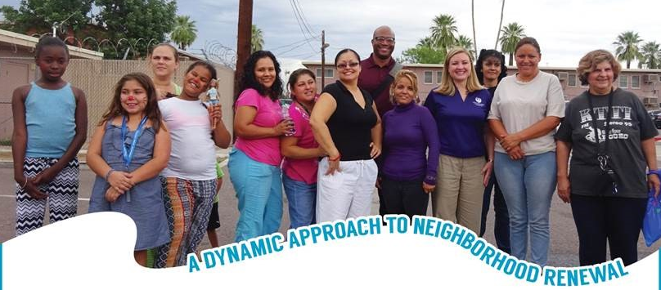
LISC Partners with the City of Phoenix on $31.5 million Grant for Edison- Eastlake!
Health Impact Assessment

Slide 12
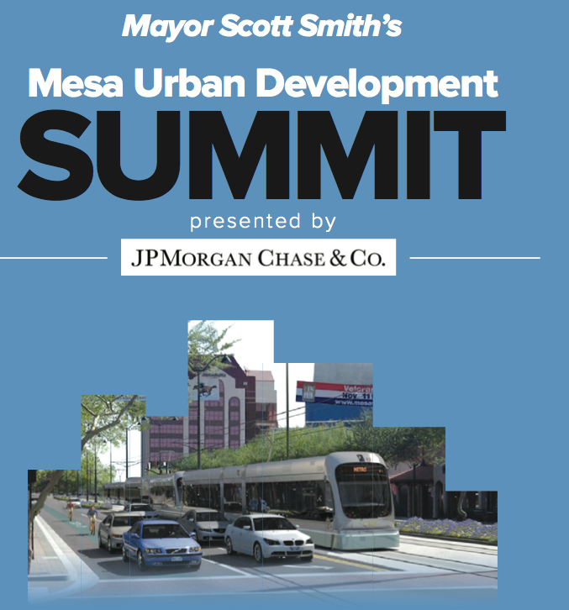
Community Design
Notes:
Community events

Slide 13
HOUSING

Slide 14
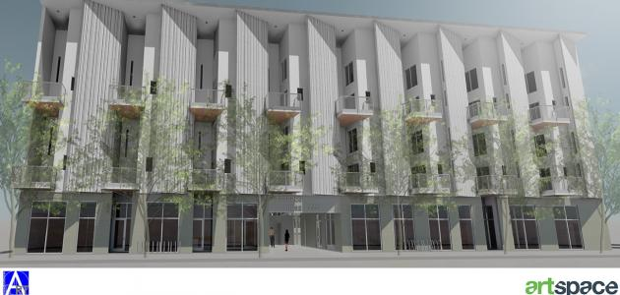
Artspace Mesa Lofts
High quality housing for artists and their families
Performance, Exhibition & Educational space
Creative business space
Close proximity to MAC and Light Rail
Notes:
50 units studio to three bedroom
Creatives self determined
Income qualified
Supportive services- after school program

Slide 15
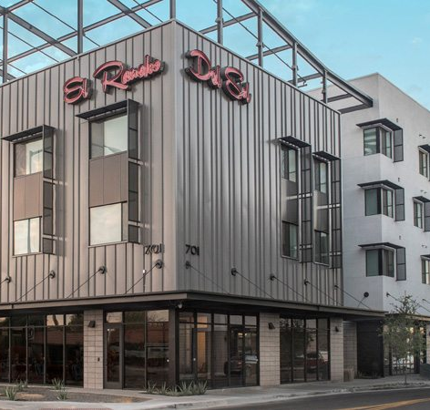
El Rancho del Sol
Community Development Partners
Main St., Mesa
47-unit Affordable Housing
$ 600,000 LISC Investment
$ 13,595,127 Total
Opened November 2017
Notes:
https://azbigmedia.com/community-development-partners-opens-el-rancho-del-sol/

Slide 16
Economic Development

Slide 17
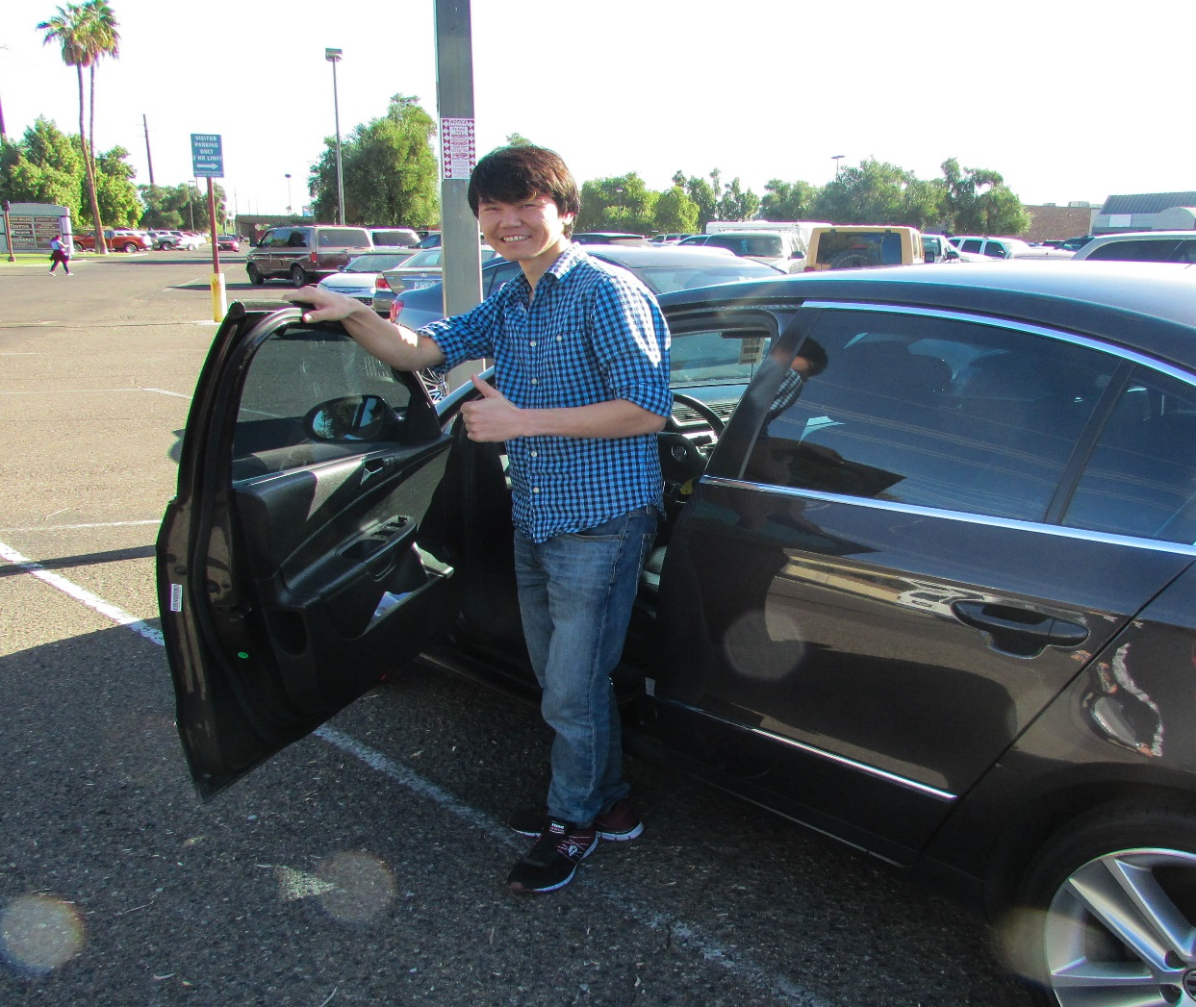
Financial Opportunity Centers (FOC)
-Income support
-Employment
-Financial Coaching

Slide 18
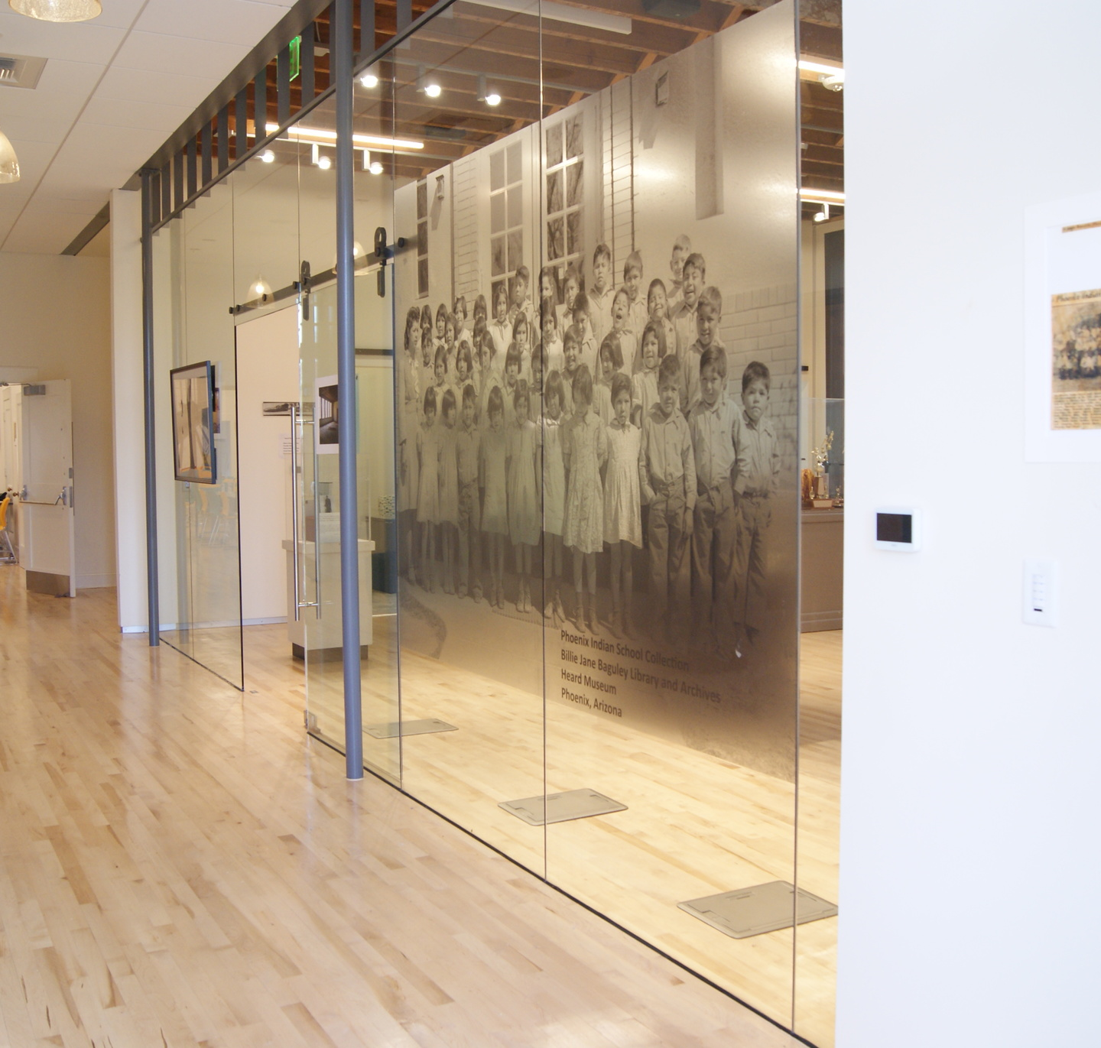
Phoenix Indian School Visitor Center
Native American Connections, City of Phoenix
Central & Indian School, Phoenix
$ 250,000 Caterpillar/LISC Grant
$ 1,550,000 Total Development Cost
Opened October 2017, Awarded LISC 2017 Exemplary Collaborative

Slide 19
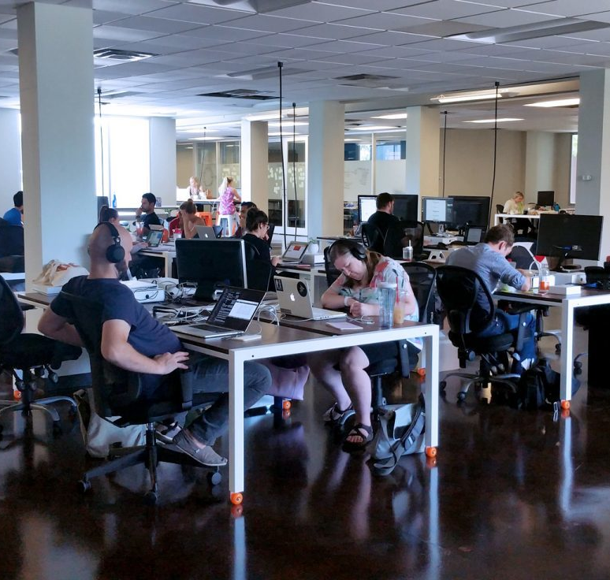
CO+HOOTS Midtown
3rd St. & Indianola, Phoenix
14,000-sq.-ft. Co-work Space
$ 1,530,000 LISC Investment
$ 1,700,000 Total Development Cost
Opened September 2016

Slide 20
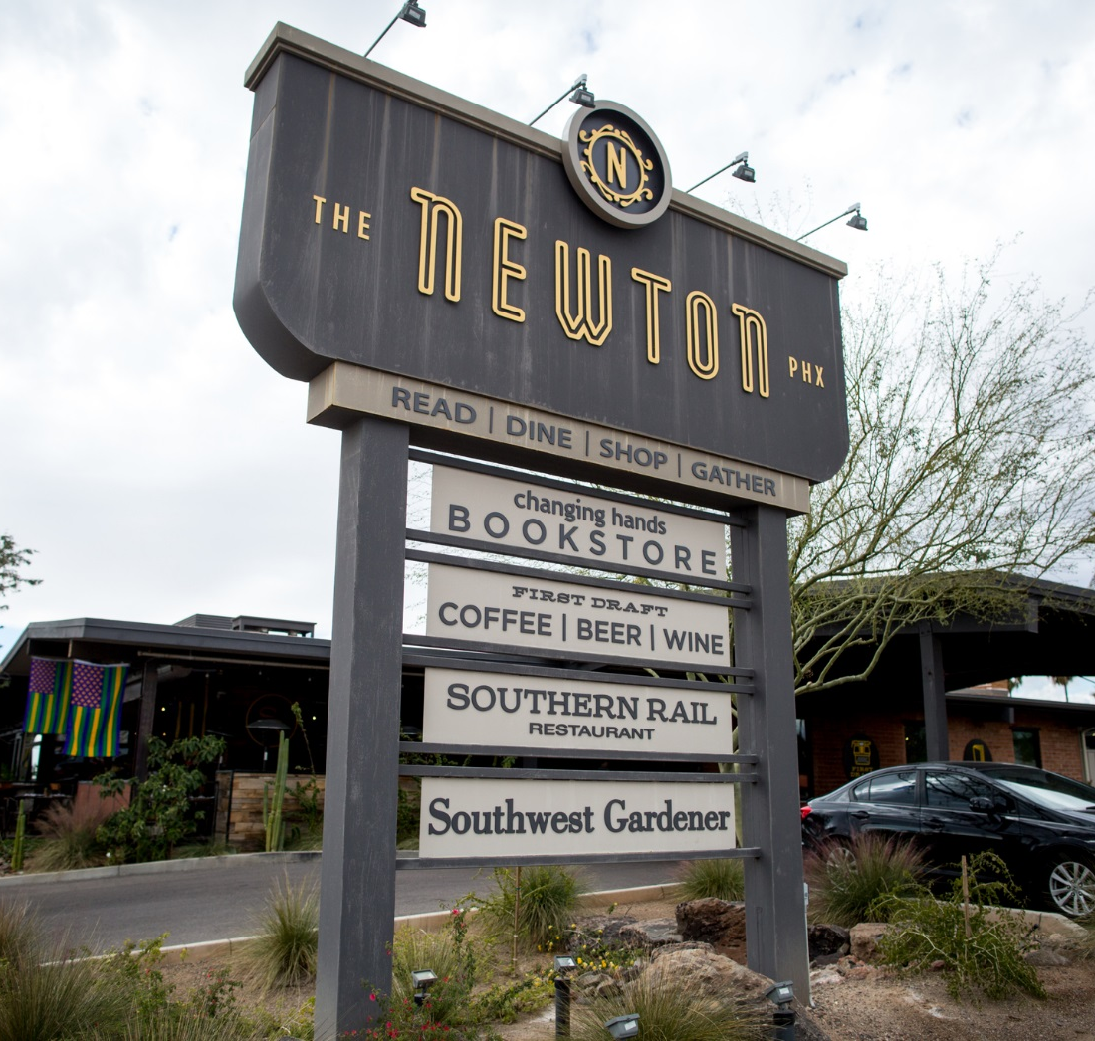
The Newton
Venue Projects
3rd Ave. & Camelback, Phoenix
18,599-sq.-ft. Commercial
$ 1,287,500 LISC Investment
$ 3,831,870 Total Development Cost
Opened 2014
Notes:
http://azarchitecture.com/blog/2014/10/becoming-the-newton-the-lessons-of-beefeaters-adaptive-reuse/

Slide 21
Healthy Communities

Slide 22
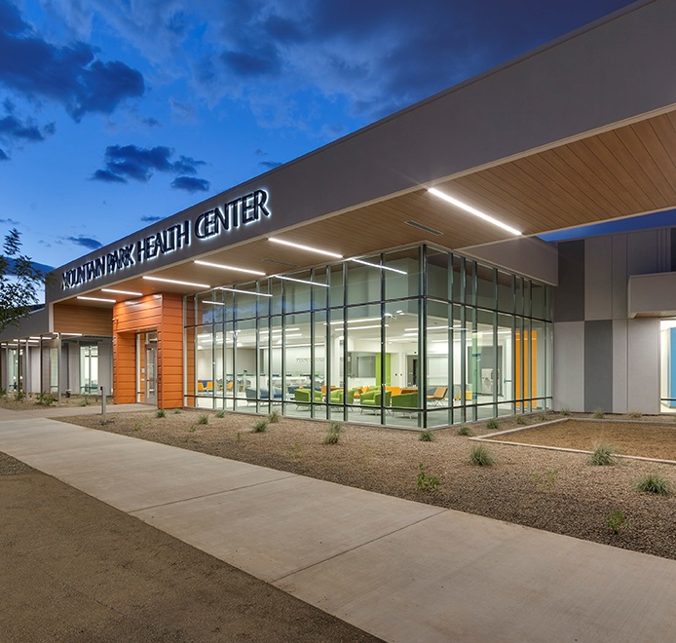
Mountain Park Health Center Tempe Clinic
Mountain Park Health Center, Healthy Futures Fund
Broadway & McClintock, Tempe
32,000-sq.-ft. Federally Qualified Health Center
$ 13,650,000 LISC Investment
$ 15,400,000 Total Development Cost
The project enabled MPHC to relocate and expand an existing health clinic to meet growing demand for its medical services. The new facility is three times larger than the former clinic, serving an additional 13,000 patients per year.
Opened 2017, Awarded LISC 2017 Exemplary Project

Slide 23
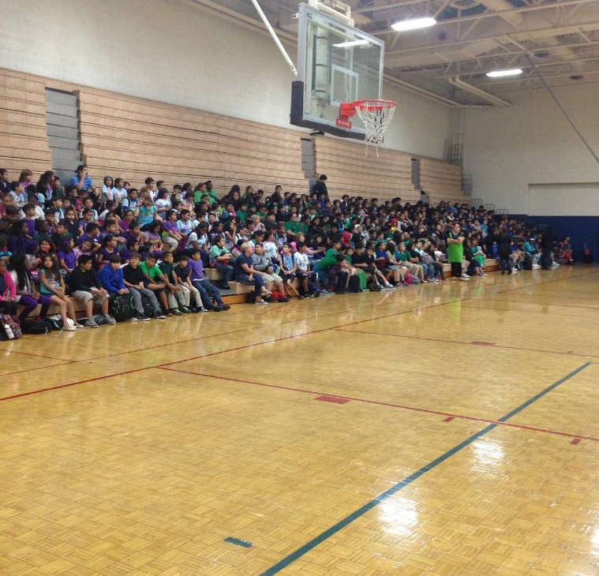

Charter schools
Notes:
With diploma- college acceptance scholarships to help pay and a plan

Slide 24
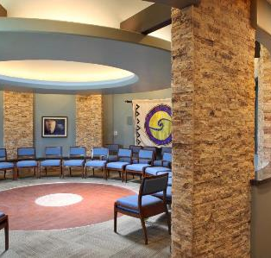
Patina Wellness Center
Native American Connections
3rd St. & Virginia, Phoenix
38,504 -sq.-ft. Residential Treatment Facility
$ 1,000,000 LISC Investment
$ 7,237,650 Total Development Cost
The Patina Wellness Center provides substance use and co-occurring treatment services focusing on the integration of mind, body, and spirit. NAC’s clinical services are holistic, strengths based, and culturally responsive. Native American traditional healing practices anchor evidence based practices to foster an empowering and supportive environment; creating a pathway to hope, wellness, and an improved quality of life.
Opened July 2016
Notes:
https://www.nativeconnections.org/behavioral-health/residential-treatment

Slide 25
“A healthy community is one where people have the opportunity to make healthy choices, in environments that are safe, and designed to promote health. Factors that influence health range from early childhood education to quality housing and jobs, and include many other areas of community development such as financial inclusion, access to health clinics, sustainable energy and transportation.”
— Build Healthy Places Network
Notes:
Community events

