Slide 2
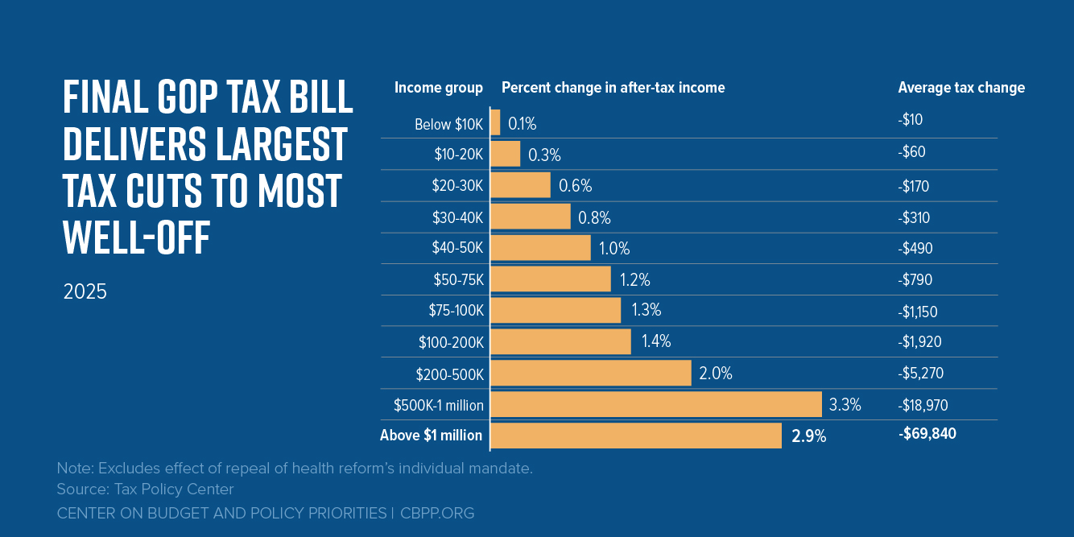

Slide 3
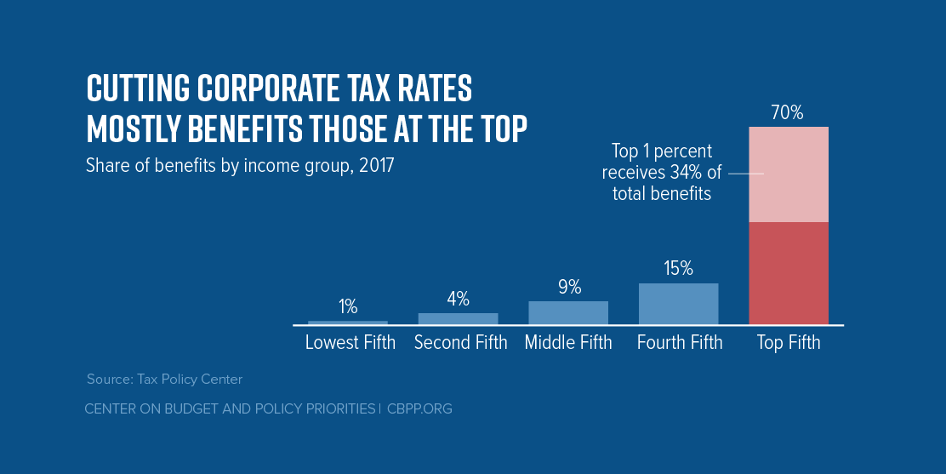

Slide 4
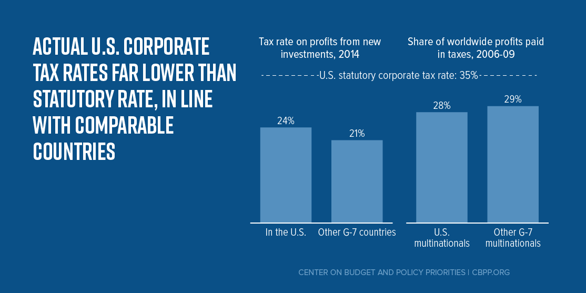

Slide 5
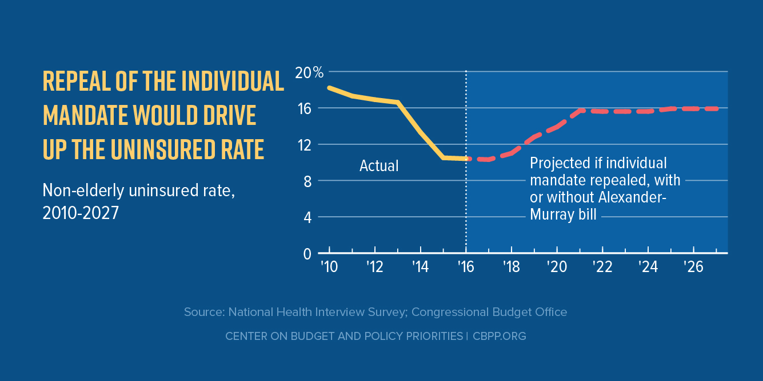

Slide 7
House Budget Committee Proposed Cuts
Entitlement Programs
Medicare $500 billion over ten years
Medicaid and ACA $1.5 trillion
SNAP, Pell Grants, SSI $1.1 trillion
Other budget areas $500 billion

Slide 8
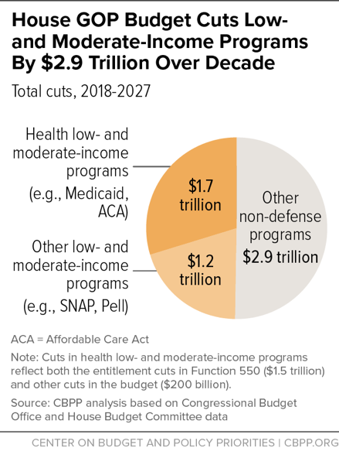

Slide 9
Contact information
David Lujan – 602-266-0707 ext 203
Dlujan@AZEconCenter.org
Social Media
Twitter @AZEconCenter
Facebook https://www.facebook.com/AZEconCenter/
Website: www.azeconcenter.org

